Slide 1


POLARITY
E-BIKES
PREPARED BY PADHMAJA K, IIM RAIPUR

Slide 2
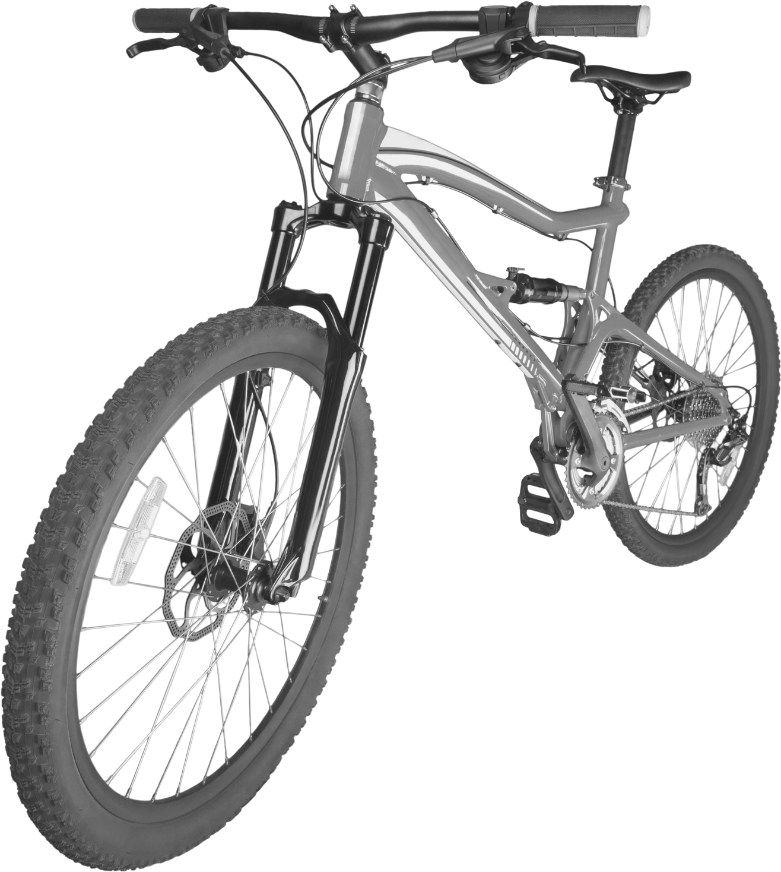
9 Step plan
Get people to talk about you
Become a Networking Pro
Consultative Selling
Know our Numbers
Everyone is Selling
Content Marketing
Automate and use tools
Turn Into Event Marketing ninja
Online Lead generation Strategy in place

Slide 3


Scripting to Success
Know what you don’t want
Imagine Ideal Dream Scenario
List of Ideal emotions we experienced
Be open to new connections
JC ROAD
Create a News Headline/ Success
Script that possesses these Qualities
Imagine having all the resources are provided

Slide 4
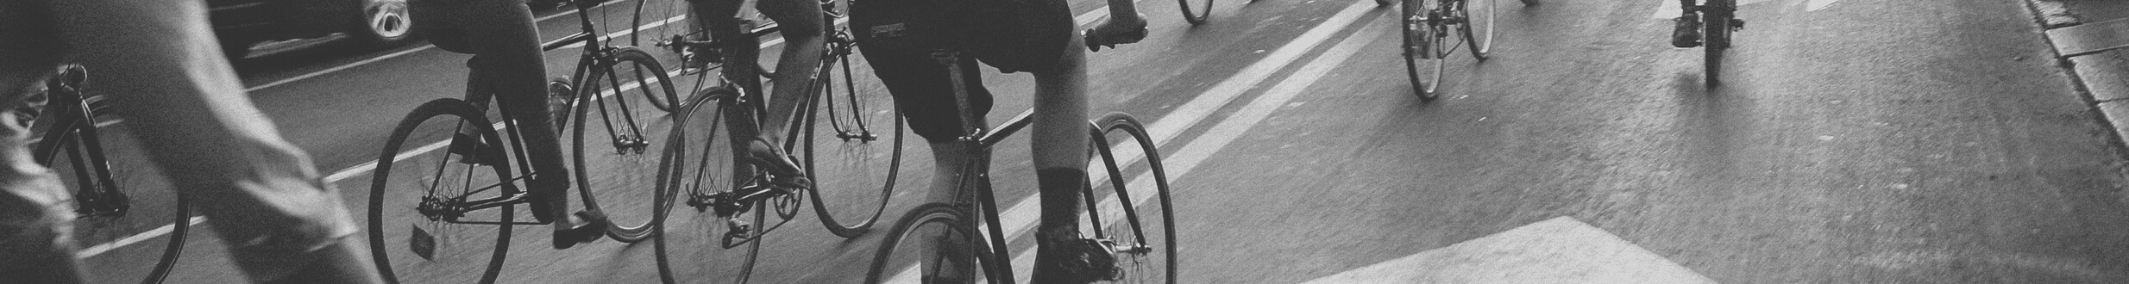
Lead Conversion Documents
LEAD RELATED LIST | CONTACT | ACCOUNT | PERSON ACCOUNT | OPPORTUNITY
Open Activities
Activity History
Campaign History
HTML Email Status
Content Deliveries
Social Posts
Social Personas
Marketing Actions

Slide 5
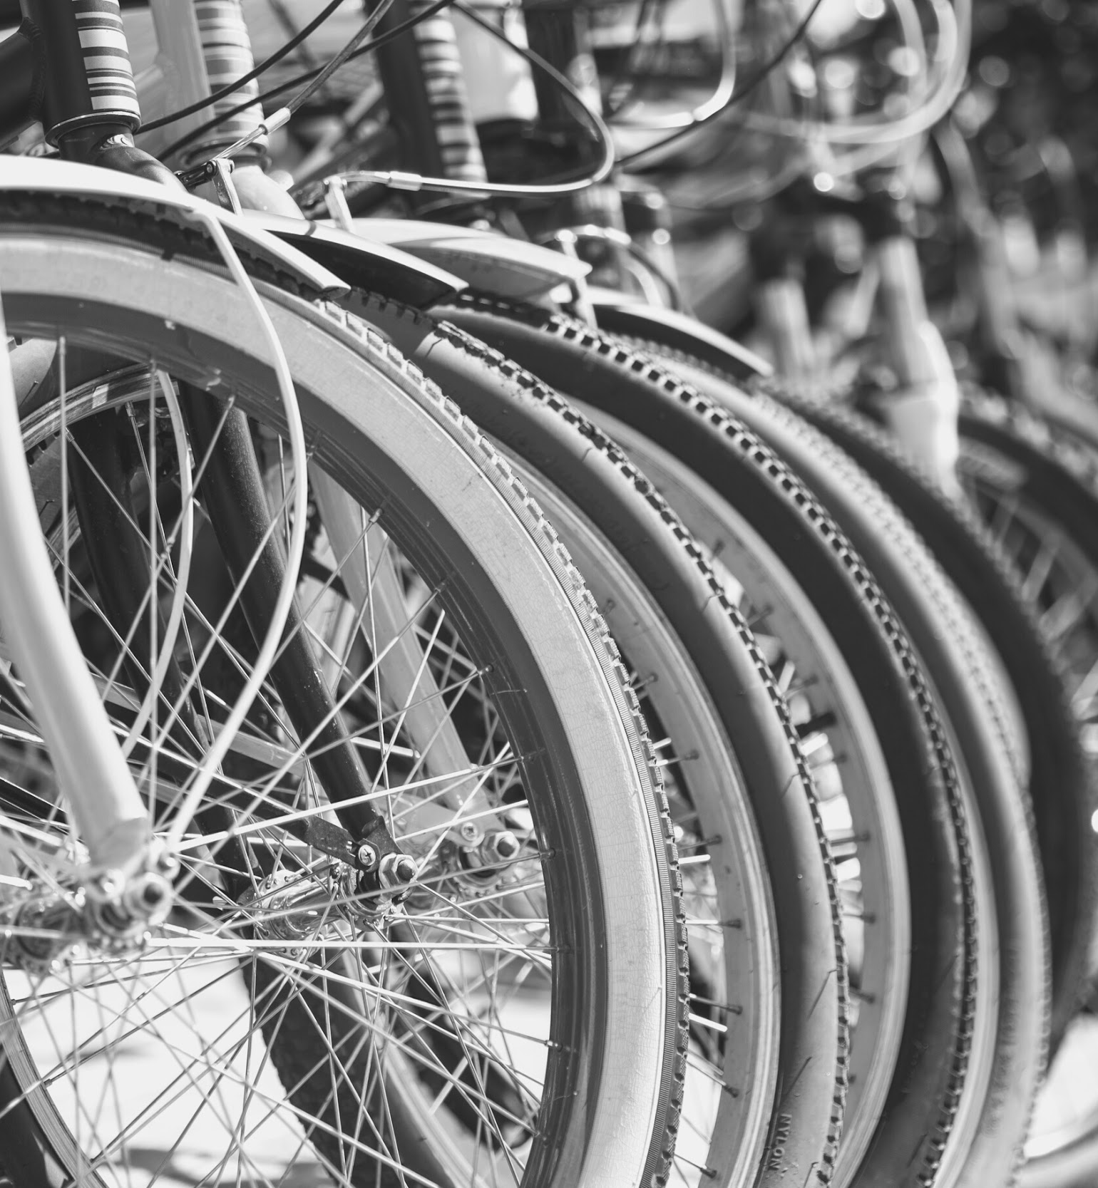
PRE-SALES COMMUNICATION
Teach how to use the E-bike
Establishing the value created
Provides Setup to leads on Technical Issues of startup and scaling

Slide 6
6 STEP PROCESS
Adding Leads to CRM
Creating Self-Service Documentation For Users
Sending Email Sequences to the Lead
Promoting product to your leads
Responding Quickly to the Leads
Analyzing Lead Data
Following up with Video and Audio Calls

Slide 7
POST-SALES COMMUNICATION
Encourage Customer Feedback
Feature the Customers
Encourage Referrals
Reward Customer Loyalty
Educate the customers regularly

Slide 8

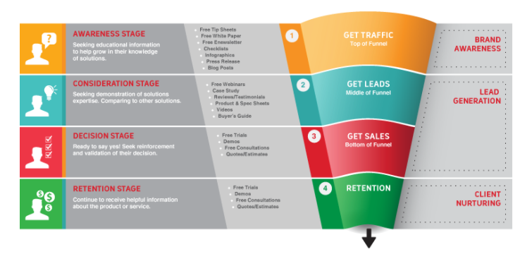
SALES FUNNEL
Get traffic – Awareness Stage
Get Leads – Consideration Stage
Get Sales – Decision Sales
Retention – Retention Stage

Slide 9
Content and Frequency
of Communication
Facebook Ad Sense
Interested People – once/twice a day
Google Ad Sense
Blogs – 1 or 2 times a week
Blogs – Quora
Social Media
Instagram – 2 times
Facebook – 1 / 2 times
LinkedIn – 1 time
Social Media Handles

Slide 10
Thank You !
PREPARED BY PADHMAJA K, IIM RAIPUR

